Slide 1
How-To Guide
Changing a Grant Manager Approver in Concur

Slide 2
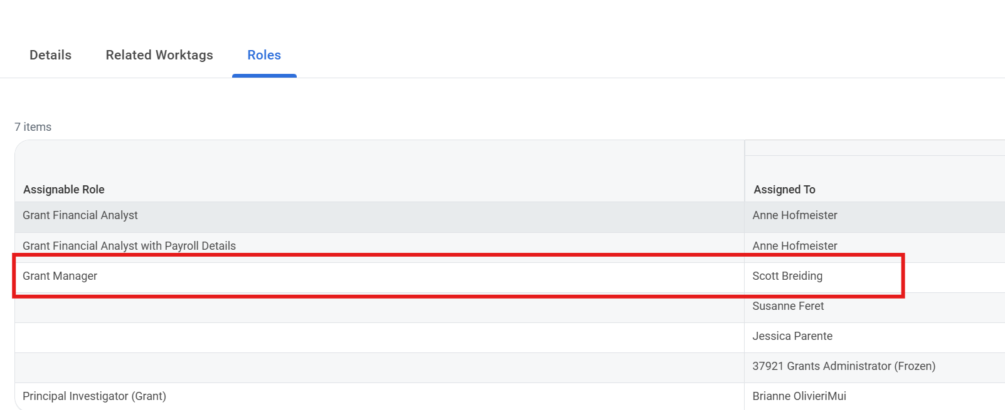
Purpose & Key Requirements
Current State
Concur reports are being delegated for approval to the first Grant manager listed in Workday under Assignable Roles.
The first Grant Manager listed under Assignable Roles must triage reports for grants they don’t manage and route them to the appropriate delegated approver, which can delay Concur approvals.
Purpose & Changes
The purpose is to update the Grant Manager Approver in Concur through a ServiceNow request.
The request must be approved by the Cost Center Manager (CCM) before changes are made in Concur.
The new Grant Manager changes must be selected from the Grant Managers listed on the grant work tag in Workday.
If the role is missing
Submit the appropriate Workday update first. The individual will not be available for the Concur change until the Workday assignment is in place.
Verify in Workday
Confirm the requested Grant Manager is already listed on the grant work tag before starting the Concur request.
Changing a Grant Manager Approver in Concur

Slide 3
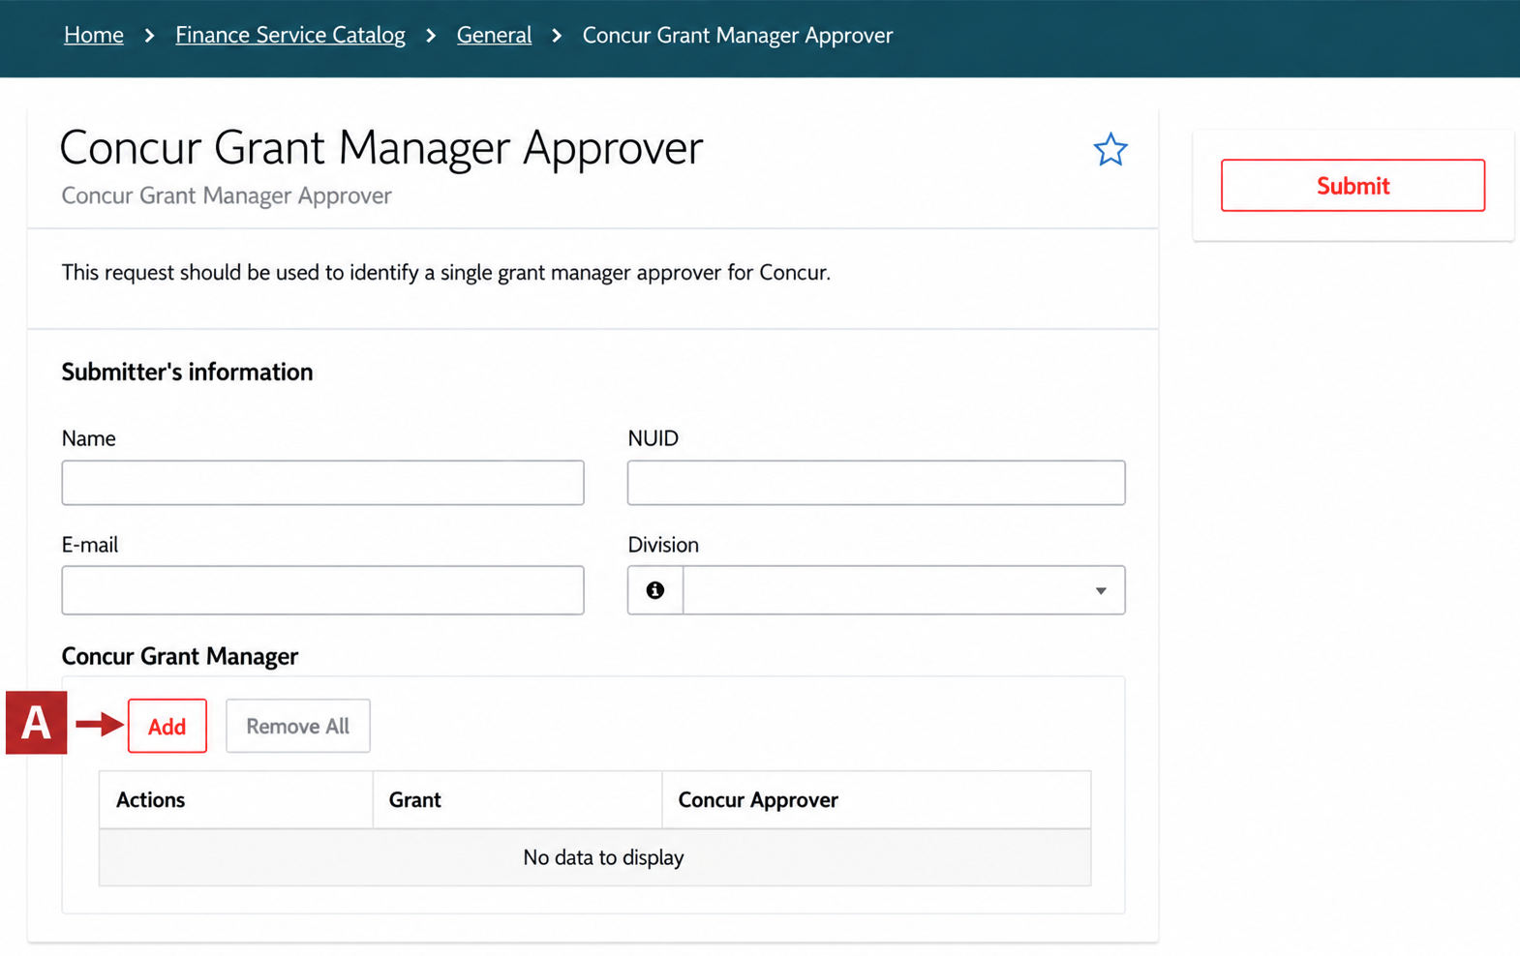
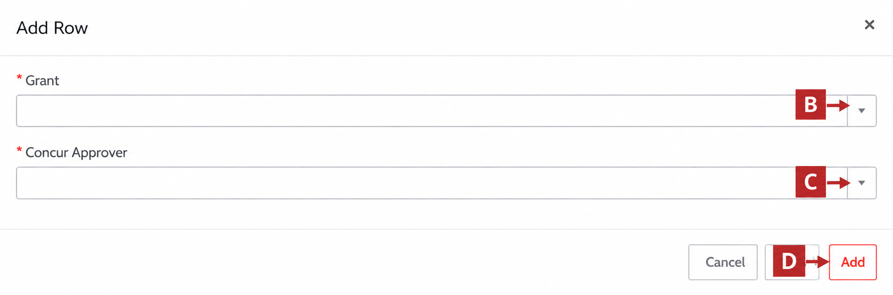
How-to Submit the Concur Grant Manager Approver
ServiceNow request
Finance Support Inquiry - Northeastern Finance Service Portal
Open the ServiceNow request and log in with your Northeastern credentials.
Under Concur Grant Manager, select Add.
Select the appropriate Grant Worktag from the drop-down list.
Then, select Grant Manager from the Concur Approver drop-down.
D. Select Add to place the row in the request.
Repeat for additional Grant Manager changes, then review and Submit.
Multiple changes
Multiple grant changes may be entered in one request. Each grant generates a separate CCM ticket and is reviewed individually.
Changing a Grant Manager Approver in Concur

Slide 4
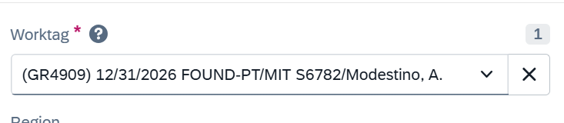
Additional Enhancements
Why the Award Line Status Matter
Award Line status determines if a grant worktag is available in Concur.
Closeout Final grants will not flow to Concur.
Subrecipient grant worktags will not flow to Concur.
What is Changing
The duplicate Grant Worktag Number will be removed in Concur.
It will be replaced with:
  Award Line Report-to Date
  Award Line Description
These fields will help users identify the correct grant.
What User Need to Do
Check the Award Line Life Cycle Status in Workday.
Confirm the grant is active before making a change in Concur.
Use the Report-to Date and Description to select the correct grant.
If the grant is missing in Concur, check its Workday status first.
Grant Worktag Number + Award Line Report-to Date & Description in Concur
Changing a Grant Manager Approver in Concur

Slide 5
Tips & Tricks
Check Workday first
Verify the Grant Manager role before opening the ServiceNow request.
Use Assignable Role
Use the Assignable Role column to identify and manage the applicable changes.
Correct one row
If an entry is wrong, remove only that row and add the correct Grant and Concur Approver.
Expect separate tickets
Each grant creates its own CCM ticket, even when several changes are submitted together.
Processing order can vary
Separate CCM tickets may not be processed in the same order the rows were entered.
Before escalating
For a missing grant or approver, check Workday roles, lifecycle status, and the relevant date information.
Changing a Grant Manager Approver in Concur

